Slide 1
Django - Heroku

Slide 2
Getting Started: Setup
Install Python, Pip & Virtualenv
Django
$ pip install django
$ pip install django-toolbelt
Heroku - create a new account
$ heroku login
Download Heroku Toolbelt
Postman - Chrome
Notes:
pip install psycopg2

Slide 3
Resolving Setup Errors/Dependencies
brew install postgresql
(if not on the Mac, use Yum, or the postgresql binary)
pip install psycopg2
OR $ brew install psycopg2
For the psycopg2 PATH error:
sudo find / -name pg_config
export PATH=<Path>:$PATH
pip install django
pip install django-toolbelt
Notes:
pip install psycopg2

Slide 4
django
The web framework for perfectionists with deadlines.

Slide 5
Django
High-level Python Web framework
Clean OOP design
Free and open source
Rapid development
authentication, content administration, site maps, RSS feeds —> out of the box
Scalable
Secure
Helps avoid SQL injection, cross-site scripting, cross-site request forgery and clickjacking.
Inbuilt user authentication system

Slide 6
Start a new project
Create a directory for your project + virtualenv
$ mkdir myfolderproject
$ cd myfolderproject

Slide 7
Virtual Environment (optional)
virtualenv is a tool to create isolated Python environments.
It creates an environment that has its own installation directories, that doesn’t share libraries with other virtualenv environments
We create the virtual environment with the flag –no-site-packages (for Virtualenv < 1.7), which indicates that only the packages installed in the virtual environment will be used.
$ virtualenv myenv <–no-site-packages>
$ source myenv/bin/activate

Slide 8
Django
While you’re in the virtual environment, install the Django Toolbelt
$ pip install django-toolbelt
$ django-admin.py startproject myproject

Slide 9
Procfile
A Procfile is a text file that declares the commands, process types and entry points that will be run by your application on the Heroku platform.
Create the file Procfile in the root directory of your app (at the same level where manage.py lives), and write:
web: gunicorn myproject.wsgi
web process type — starting a web server
gunicorn the production web server recommended for Django

Slide 10
Requirements
"Requirements files" are files containing a list of items to be installed using pip install
Used to hold the result from pip freeze for the purpose of achieving repeatable installations. In this case, your requirement file contains a pinned version of everything that was installed in your virtualenv when pip freeze was run.
$ pip install gunicorn
$ pip freeze > requirements.txt
$ pip install dj-database-url
$ pip freeze > requirements.txt

Slide 11
Requirements
Here’s a sample requirements.txt file
dj-database-url==0.4.0
dj-static==0.0.6
Django==1.9.2
django-toolbelt==0.0.1
gunicorn==19.4.5
psycopg2==2.6.1
static3==0.6.1
wheel==0.24.0
Notes:
For the psycopg2 error:
sudo find / -name pg_config
export PATH=<Path>:$PATH
Restart Terminal

Slide 12
Settings
Add your project name to the end of the INSTALLED_APPS list
INSTALLED_APPs: [….., ’myproject’ ]
To the end of the settings.py file add the following code…
# Honor the 'X-Forwarded-Proto' header for request.is_secure()
SECURE_PROXY_SSL_HEADER = ('HTTP_X_FORWARDED_PROTO', 'https')
# Allow all host headers
ALLOWED_HOSTS = ['*']
# Static asset configuration
import os
BASE_DIR = os.path.dirname(os.path.abspath(__file__))
STATIC_ROOT = 'staticfiles'
STATIC_URL = '/static/'
STATICFILES_DIRS = (
os.path.join(BASE_DIR, 'static'),
)

Slide 13
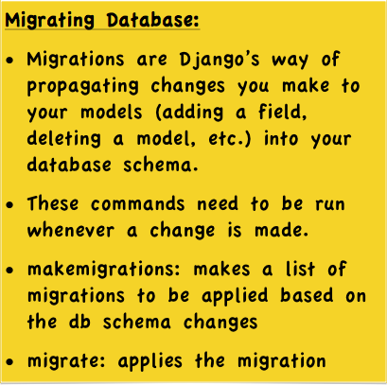
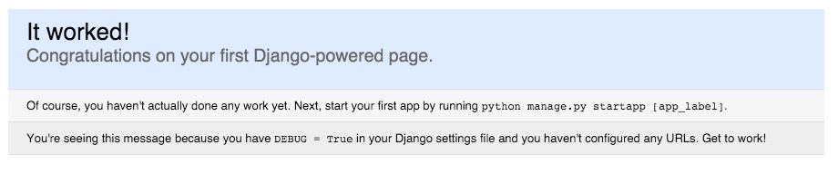
Test
$ python manage.py makemigrations
$ python manage.py migrate
$ python manage.py runserver
If you’ve done everything correctly, you should see this….
Notes:
Add this to the bottom of your settings.py file

Slide 14
models.py
Create a new models.py file at the same level as your settings.py
from django.db import models
import json, re
class DPUser(models.Model):
first_name = models.CharField(max_length=50)
last_name = models.CharField(max_length=50)
email = models.CharField(max_length=50)
def getResponseData(self):
response_data = {}
response_data["first_name"] = self.first_name
response_data["last_name"] = self.last_name
response_data["email"] = self.email
return response_data

Slide 15
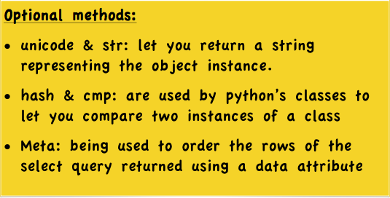
models.py
def __unicode__(self):
return self.first_name
def __str__(self):
return self.first_name
def __hash__(self):
return self.id
def __cmp__(self, other):
return self.id - other.id
class Meta:
ordering = ('first_name',)
Notes:
Create a new models.py file at the same level as your settings.py

Slide 16
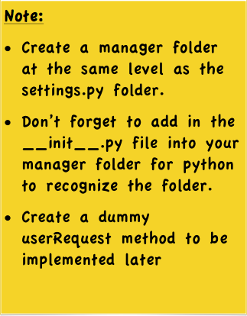
UserManager
In your UserManager.py file (manager/UserManager.py)
import json
from django.views.decorators.csrf import csrf_exempt
from django.http import HttpResponse
from ..models import DPUser
@csrf_exempt
def userRequest(request, user_id=None):
return HttpResponse(json.dumps({‘success’:True}), content_type="application/json")
Notes:
manager/UserManager.py
manager/__init__.py

Slide 17
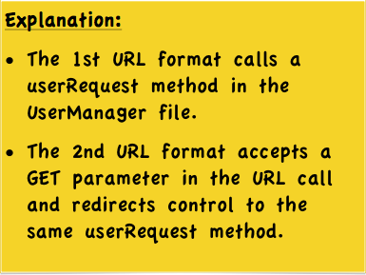
urls.py
Add the following code into your urls.py file
from manager import UserManager
#add the url pattern below
url(r'^api/user/$', UserManager.userRequest),
url(r'^api/user/(?P<user_id>\d*)/$', UserManager.userRequest)
Notes:
manager/UserManager.py
manager/__init__.py

Slide 18
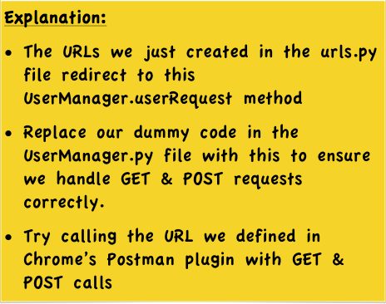
UserManager
@csrf_exempt
def userRequest(request, user_id=None):
if request.method == "POST":
errorMessage = "TODO POST"
response_data = {'success': True, "error":errorMessage}
else:
errorMessage = "TODO GET"
response_data = {'success': True, "error":errorMessage}
return HttpResponse(json.dumps(response_data), content_type="application/json")

Slide 19
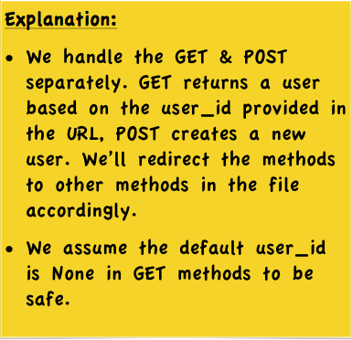
UserManager
@csrf_exempt
def userRequest(request, user_id=None):
if request.method == "POST":
return createUser(request)
else:
return getUser(request, user_id)

Slide 20
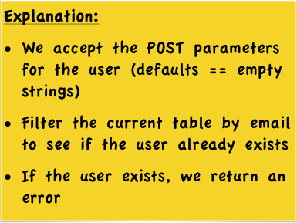
UserManager
@csrf_exempt
def createUser(request):
first_name = request.POST.get('first_name','')
last_name = request.POST.get('last_name','')
email = request.POST.get('email','')
user = None
existing_users = DPUser.objects.filter(email=email)
if len(existing_users) > 0:
# User Exists!
user = existing_users[0]
errorMessage = "Error! User with this email already exists."
return HttpResponse(json.dumps({'success': False, "error":errorMessage}), content_type="application/json")

Slide 21
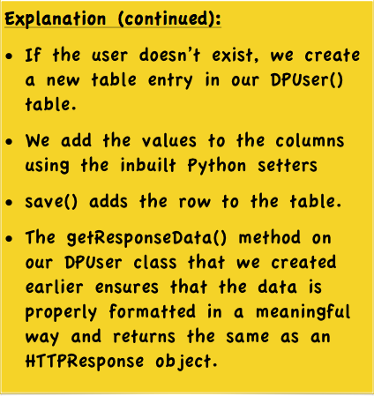
UserManager
if user is None:
user = DPUser()
user.first_name = first_name
user.last_name = last_name
user.email = email
user.save()
response_data = user.getResponseData()
return HttpResponse(json.dumps(response_data), content_type="application/json")

Slide 22
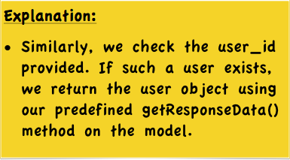
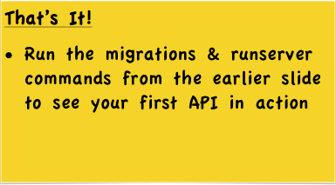
UserManager
@csrf_exempt
def getUser(request, user_id):
response_data = {}
if user_id:
users = DPUser.objects.filter(id=user_id)
if len(users)>0:
user = users[0]
response_data = user.getResponseData()
else:
errorMessage = "Error! This user doesn't exist."
response_data = {'success': False, "error":errorMessage}
return HttpResponse(json.dumps(response_data), content_type="application/json")

Slide 23
Heroku

Slide 24
Heroku Account
Login to your Heroku account
Create new app (eg. masdjango)
On the Terminal:
heroku login
heroku git:clone -a masdjango
git add —all
git commit -m “Deploying to Heroku”
git push heroku master

Slide 25
Links
Github for the django project

